Slide 1
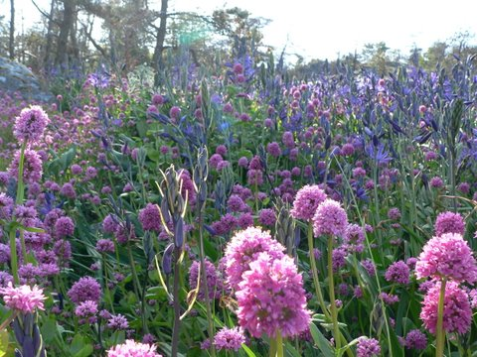

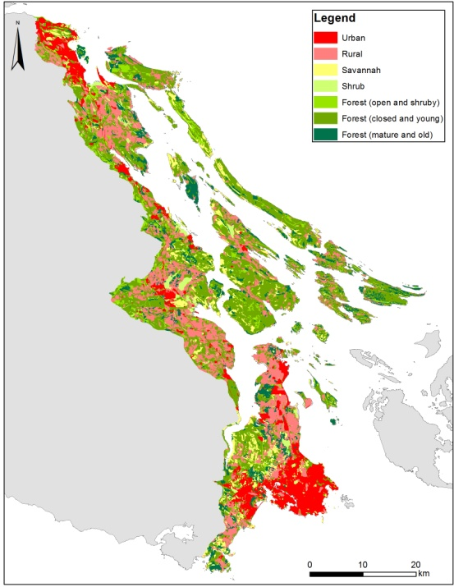
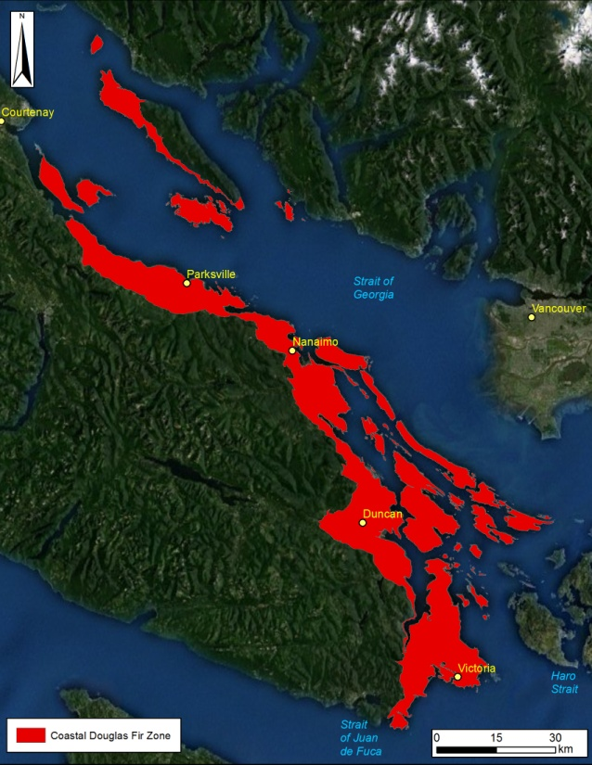
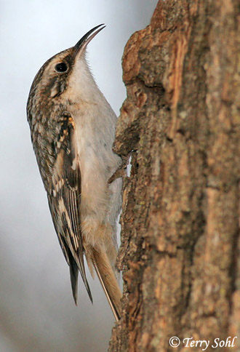
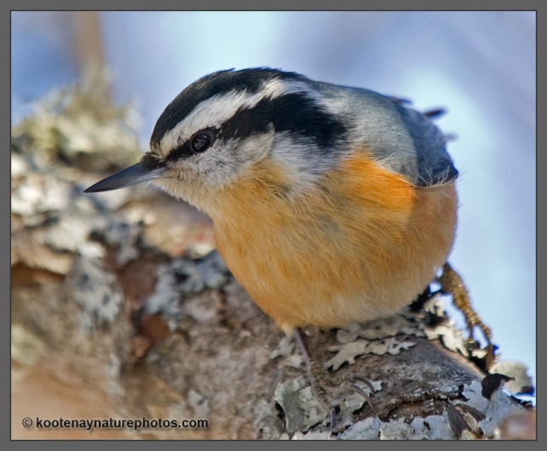
Conservation Prioritization: Species Distribution Models
Richard Schuster
Liber Ero Fellow
Geomatics and Landscape Ecology Lab
Carleton University

Slide 2
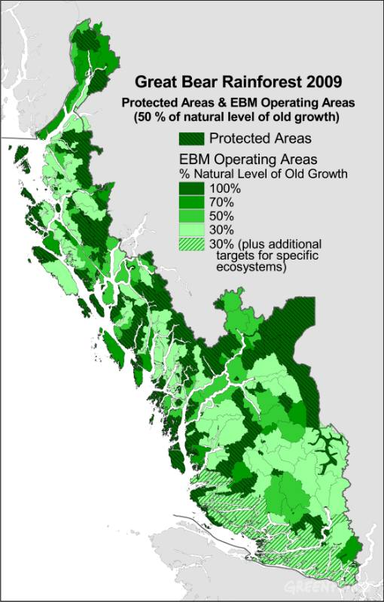
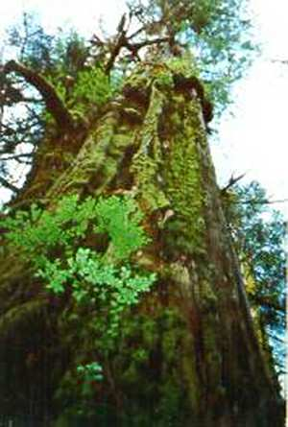
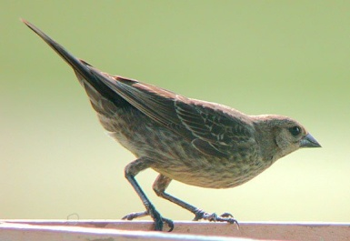
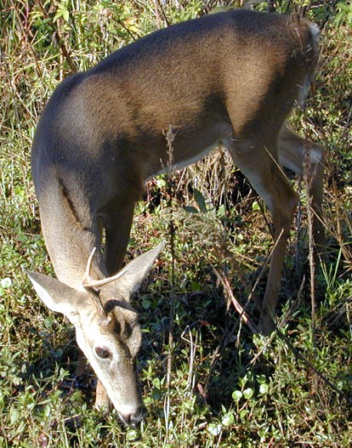
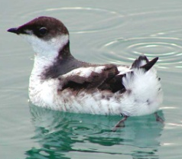
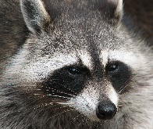
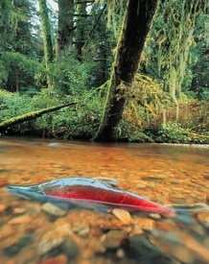
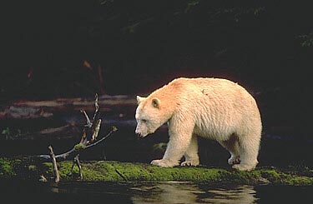
Traditional Goal of Conservation Area Design
Prioritize and Conserve ‘Intact’ or ‘Relic Ecosystems’
Multiple criteria
Decision support tools (Marxan)
Impractical in Human-dominated Landscapes
No Benchmark Ecosystems
Biological Survey Data Often Biased
Many Threats Hard to Map

Slide 3
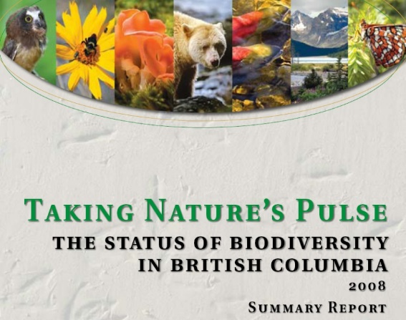
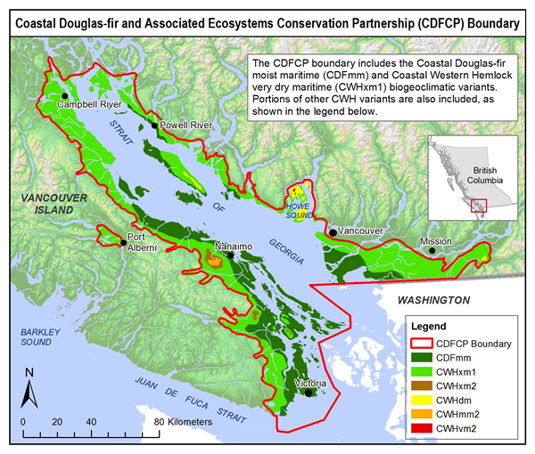
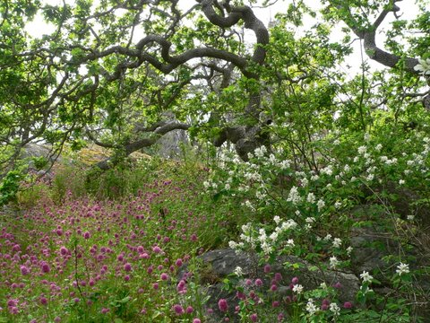
Coastal Douglas Fir Biogeoclimatic zone
Most Imperilled Ecosystem in BC
>60% Converted to Human Use
~84% Private Land
115 ‘Species At Risk’
Study area: ~2500 km²
Austin et al. (2008); Madrone Env. Services (2008)

Slide 4
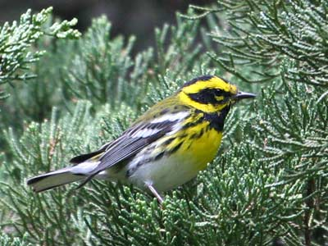
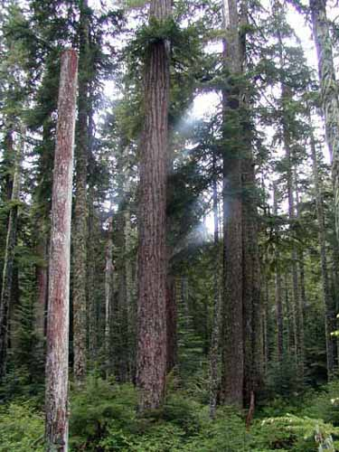

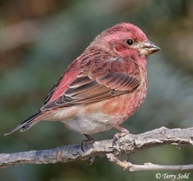
Use Indicator Species to Identify Areas that Support Historically Representative Communities
Specifically
Native Old-forest communities
Insulated from Negative Human Impacts
Our Approach
Map Distribution of Wide-spread, Easily Detected Indicators
Use composite maps to identify areas most likely to support native, old forest communities

Slide 5
Species Distribution Models
Ecological question: What is the species occurrence probability in an area?
Some uses:
Estimating occurrence or abundance patterns
Ecological restoration
Risk and Impacts of Invasive Species
Reserve design and conservation planning

Slide 6
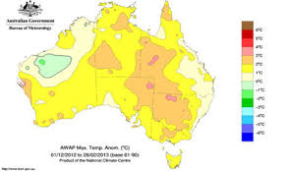

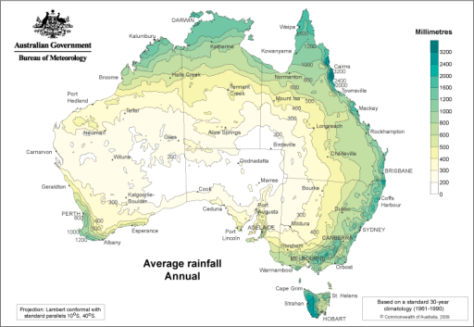
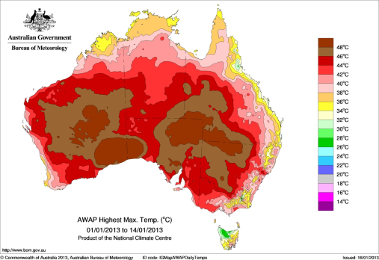
Predictive modelling of species geographic distribution based on the environmental conditions (Phillips et al 2006).
Main Assumption: Species distribution are predictable from environmental variables.
Ocurrence probability $=f\left(environmental conditions\right)$
Species Occurrences
(geographic coordinates X,Y)
Prediction
Response variable:
Probability of presence
Covariates: Environmental data
Maria Angelica Lopez-Aldana 2015

Slide 7
SDM: Data types and methods
Type of data
Presence/absence data
Detection/non-detection data
Presence only data
Herbarium or museum data
ManEnt, Maximum Entropy
Repeat visits to a site
Systematic Biological Survey
GLM/GAM
Site-occupancy models
BRT/RF

Slide 8
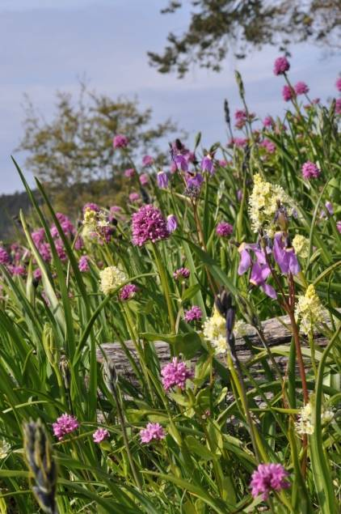
Use SDM’s in Conservation Area Design
Inform conservation decision-making
Identify good + efficient actions in space + time
Optimize allocation of finite resources
Moilanen et al. (2009)

Slide 9
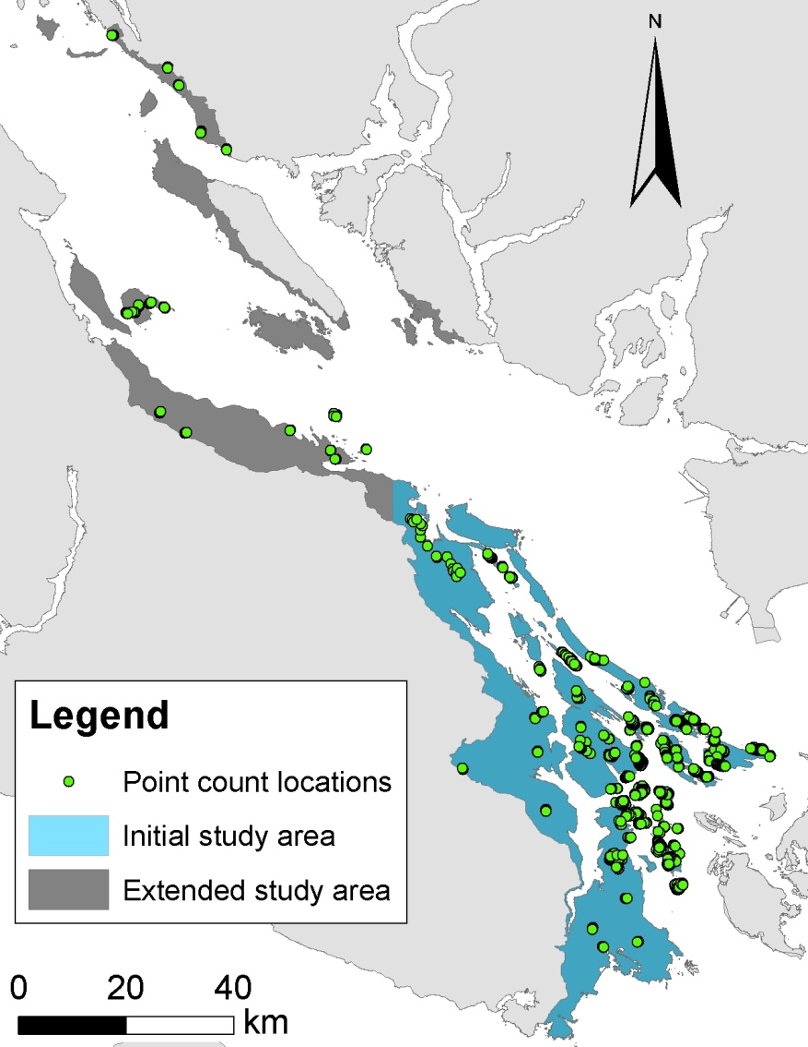
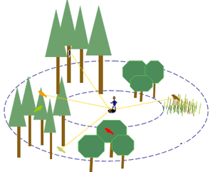
CDF Point Counts
2005 - 2011 (except 2006)
726 locations
Records for 80+ species
Record every bird heard or seen for 10‘ within 50m
5am – 12pm
Repeat visits
Source: USGS

Slide 10
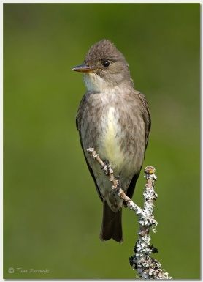
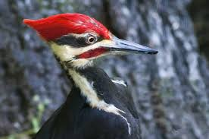
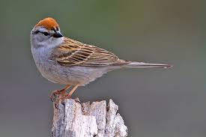
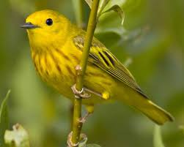
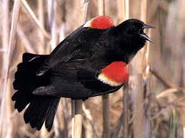
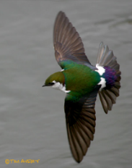

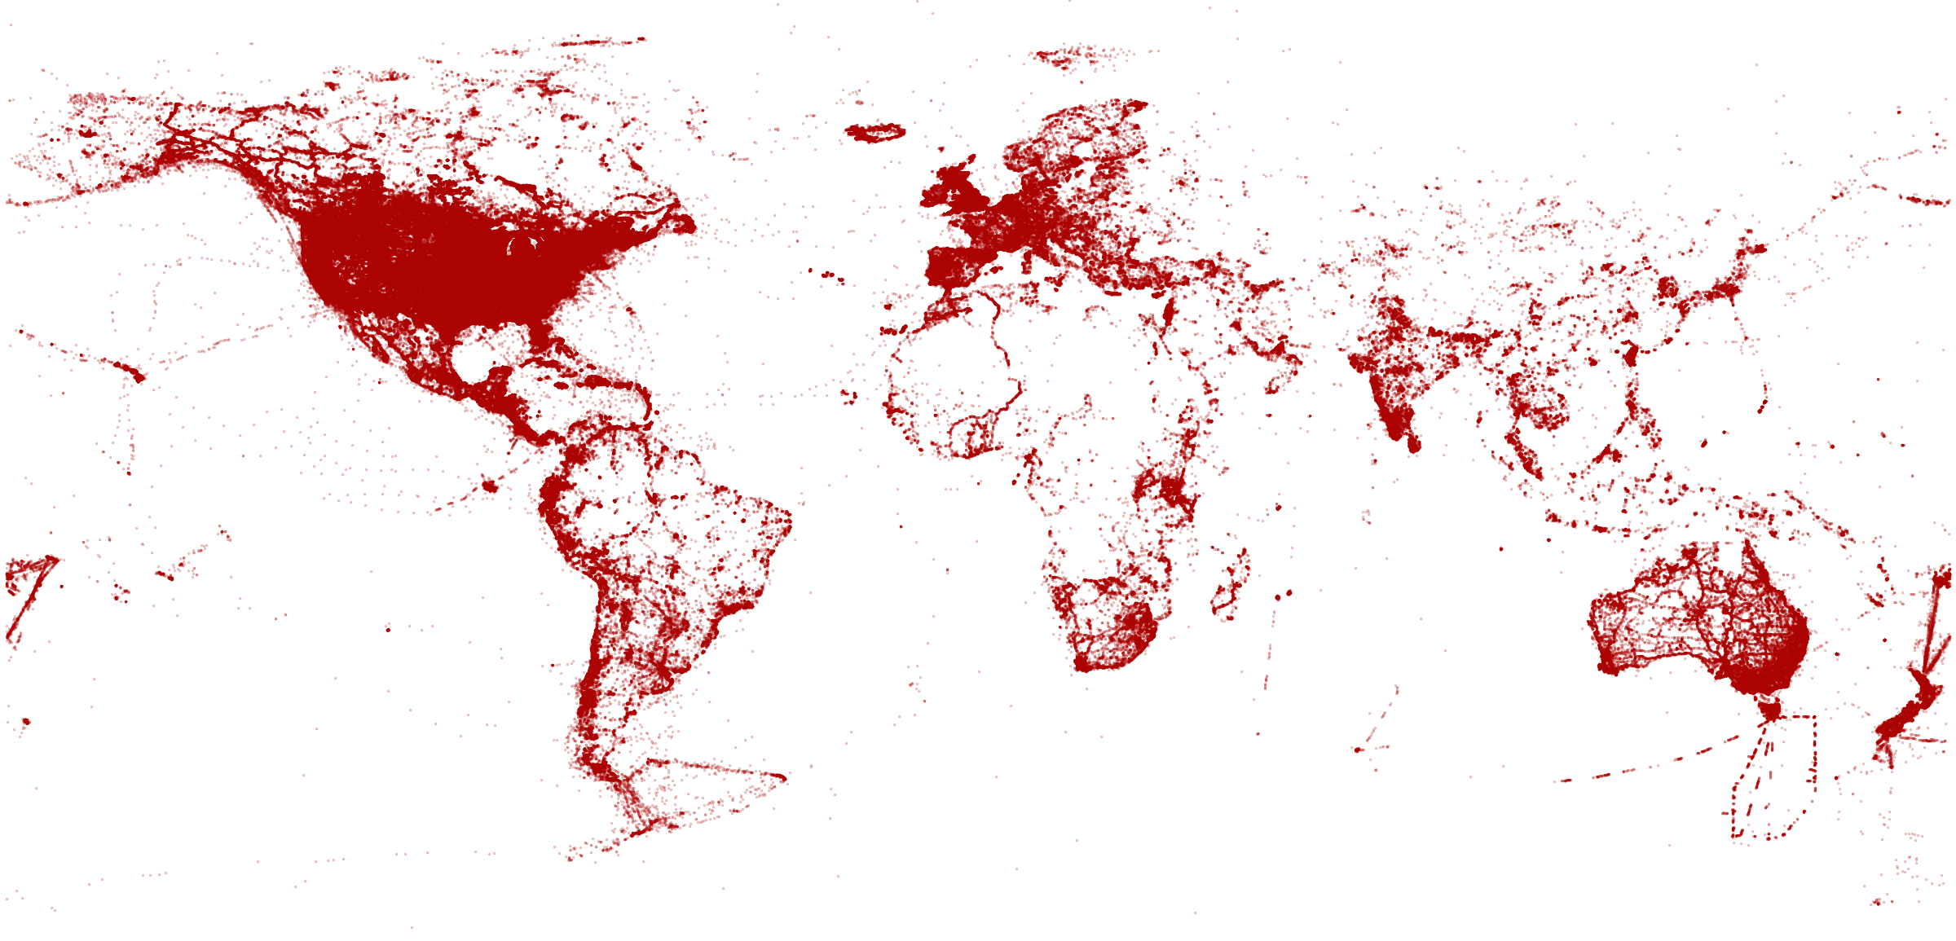
Predict Conservation Value from the Distributions of Focal Indicators
93,000 eBird data points of detection/non-detection
27 Landscape and 5 Current and Future Climate variables and AIC to map ‘Occupancy’
74 Species with ≥ 50 Detections, representing 34 Families
Assembled into Communities by Experts given ‘Habitat Reliance’
Notes:
1. Can an old forest reliant bird species community be used to identify high priority areas of mature forest for old growth restoration?

Slide 11
Model covariates
Coarse (1km) and fine scale (100m)¹
25 landscape covariates
Using: Hawth‘s Tools, ArcGIS, Geospatial Modelling Environment, R
¹Guisan and Thuiller, 2005; Jewell et al., 2007

Slide 12
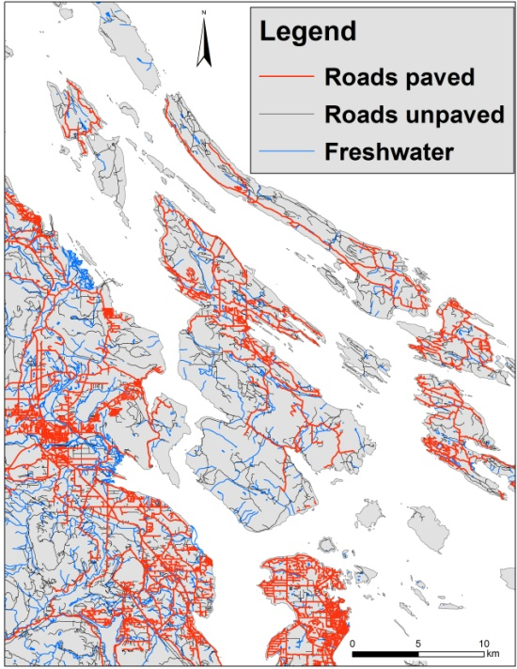
Landscape Covariates
Terrain Resource Information Management (TRIM)
Unpaved road length (100m, 1km)
Paved road length (100m, 1km)
Nearest road
Nearest freshwater
TRIM

Slide 13
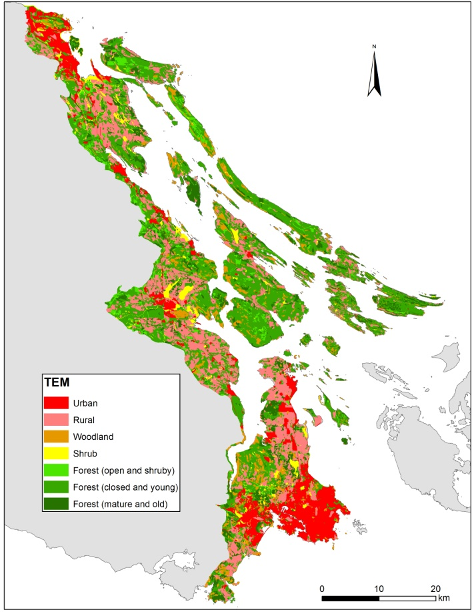
Landscape Covariates
Terrestrial Ecosystem Mapping (TEM)¹
Herbaceous (100m, 1km)
Shrub (100m, 1km)
Forest – closed and young (100m, 1km)
Forest – mature and old (100m, 1km)
Savannah (100m, 1km)
Wetland (100m, 1km)
Rural/agriculture (100m, 1km)
Urban/industrial (100m)
Distance to nearest urban
TEM
¹MES, 2008

Slide 14
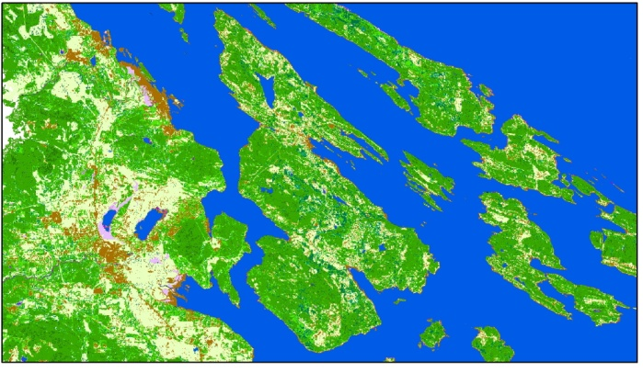
Landscape Covariates
Earth Observation for Sustainable Development (EOSD)¹
Landsat based
Crown closure within a 100m buffer, combining EOSD crow closure categories (dense, open and sparse) into one measure
Air photos
Island size
Nearest shoreline
¹Wulder et al., 2008
EOSD

Slide 15
Occupancy and detection models
Account for imperfect detectability
A “law” of ecology: you never see them all!
Two part models: Occupancy and Detectability (Mackenzie et al., 2002)
Assumptions:
Closed populations
No false detections
Detections independent
R package unmarked (Fiske et al., 2010)

Slide 16
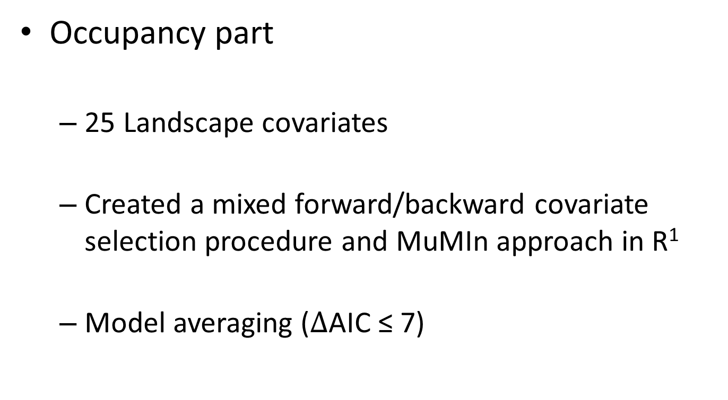
Occupancy and detection models
Occupancy part
25 Landscape covariates
Created a mixed forward/backward covariate selection procedure and MuMIn approach in R¹
Model averaging ($∆$AIC ≤ 7)
¹Schuster and Arcese, 2013

Slide 17
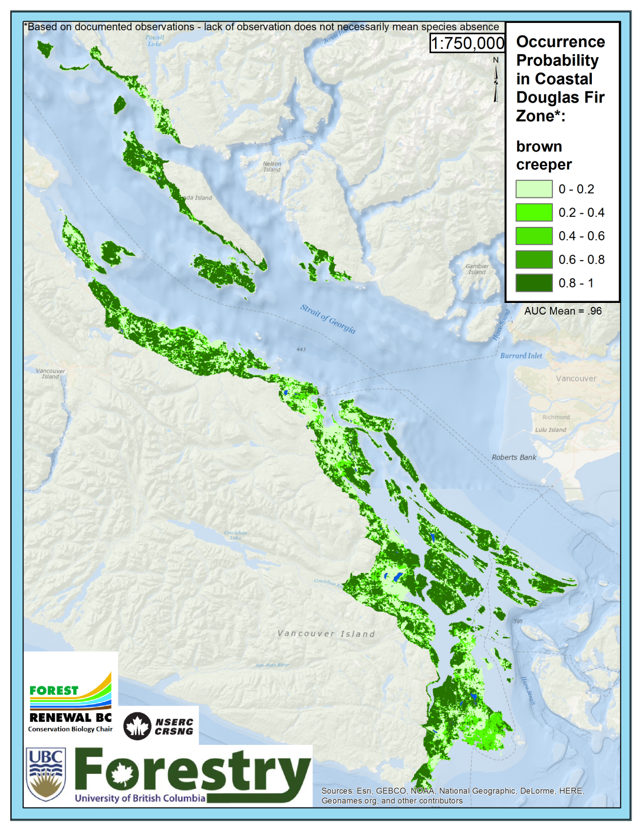

Brown Creeper
Positive:
Crown closure
Herbaceous
Young forest
Island Size
Negative:
Unpaved roads
Shrub
Wetland

Slide 18
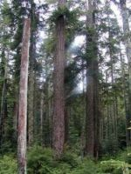
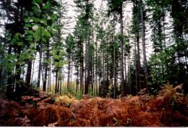
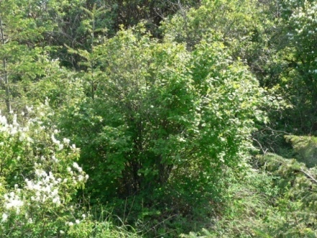
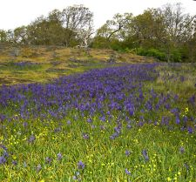
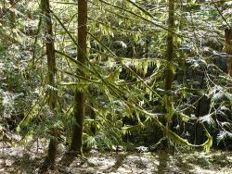
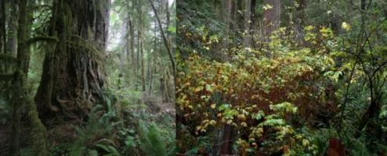
Expert ranking of bird species habitat associations
Online and Excel survey
12 expert birders
47 bird species
10 habitat types/structural stages
low/medium/high reliance
Notes:
https://www.surveymonkey.com/r/WPBVS9S
Richard Cannings, Sydney Cannings, Neil Dawe,
Katie Aitken, Russel Cannings, Karen Ferguson, David Green, Susan Hannon, Kelly Jewell, Tara Martin, Andrea Norris and Laura Sampson

Slide 19
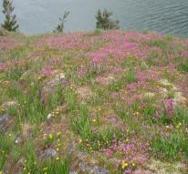
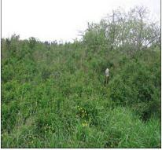
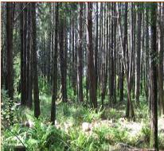
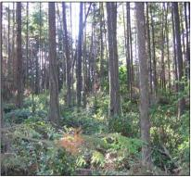
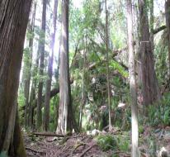
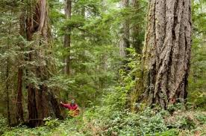
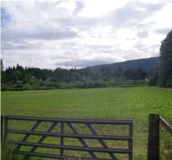



Habitat types
Herbaceous | Shrub/Herb | Pole/Sapling | Young Forest | Mature Forest
Old Forest | Rural/Agriculture | Urban/Industrial | Woodland | Wetland

Slide 20
Old Forest score example
Herbaceous
Shrub
Pole/Sapling
Young Forest (40-80y)
Mature Forest (80-250y)
Old Forest (>250y)
Old forest association =
Notes:
Richard Cannings, Sydney Cannings, Neil Dawe,
Katie Aitken, Russel Cannings, Karen Ferguson, David Green, Susan Hannon, Kelly Jewell, Tara Martin, Andrea Norris and Laura Sampson

Slide 21








Expert rankings
Species | Association Score | Map Weight
Brown Creeper | 0.81 | 0.11
Red-breasted Nuthatch | 0.79 | 0.11
Chestnut-backed Chickadee | 0.75 | 0.10
Golden-crowned Kinglet | 0.77 | 0.10
Pacific-slope Flycatcher | 0.63 | 0.09
Pine Siskin | 0.69 | 0.09
Townsend's Warbler | 0.69 | 0.09
Pacific Wren | 0.63 | 0.08
Purple Finch | 0.58 | 0.08
Yellow-rumped Warbler | 0.56 | 0.08
Olive-sided Flycatcher | 0.46 | 0.06
Wilson's Warbler | 0.06 | 0.01
Rufous Hummingbird | -0.07 | -
Song Sparrow | -0.36 | -
Spotted Towhee | -0.03 | -
White-crowned Sparrow | -0.66 | -
Dark-eyed Junco | -0.03 | -
Orange-crowned Warbler | -0.05 | -
Notes:
Richard Cannings, Sydney Cannings, Neil Dawe,
Katie Aitken, Russel Cannings, Karen Ferguson, David Green, Susan Hannon, Kelly Jewell, Tara Martin, Andrea Norris and Laura Sampson

Slide 22






Slide 23
Additional scores
(13 species)
(3 species)
Wetland (8 species)
Shrub (19 species)

Slide 24


Savannah Human Commensal

Slide 25


β-Diversity: Where do We Maximize the Old Forest and Savanna Communities?

Slide 26




Wetland Bird Communities

Slide 27


Anadromous fish (n = 12) Herptiles (n = 12)

Slide 28

Fish and Herpile Summed Occurrence Probabilities
Chinook, Coho, Chum, Sockeye, and Pink Salmon
Dolly varden, Steelhead, Rainbow trout, Coastal Cutthroat and Kokanee
Chorus, Columbia Spotted, and Red Legged frog, Western toad
Western, Common and NW garter snake
Long-toed, NW and Red-backed, Wandering salamander, Rough skinned newt

Slide 29
Critical Habitat
Sand-verbena Moth (Copablepharon fuscum)
Marbled Murrelet (Brachyramphus marmoratus)
Oregon Forestsnail (Allogona townsendiana)
White Meconella (Meconella oregana)
Macoun's Meadowfoam (Limnanthes macounii)
California Buttercup (Ranunculus californicus)
Coast Microseris (Microseris bigelovii)
Contorted-pod Evening-primrose (Camissonia contorta)
Dense-flowered Lupine (Lupinus densiflorus)
Dense Spike-primrose (Epilobium densiflorum)
Foothill Sedge (Carex tumulicola)
Fragrant Popcorn Flower (Plagiobothrys figuratus)
http://donnees.ec.gc.ca/data/species/developplans/critical-habitat-for-species-at-risk-british-columbia/?lang=en

Slide 30


Slide 31









Thank you
Notes:
31

